Slide 1

MINING GUN VOILENCE
By Taban Yolo
ETM 531

Slide 2
THE DATA
Obtained from kaggle.com
Original data contains 30+ COLUMNS AND 200,000+ CASES
TRAIN MODEL CONTAINED 40,000 CASES
TEST MODEL CONATINED 10,000 CASES

Slide 3
PURPOSE OF RESEARCH
TO FIND WHAT VARIABLES BEST PREDICT NUMBER OF PEOPLE KILLED DURING EVERY GUN VOILENCE INDCIDENT

Slide 4
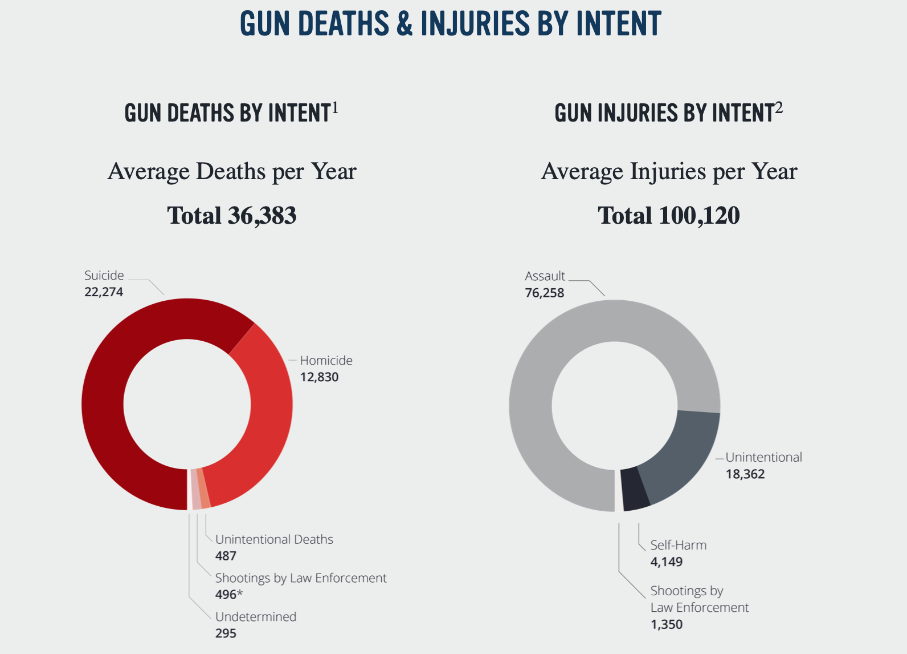
INTRODUCTION
Notes:
https://everytownresearch.org/gun-violence-america/

Slide 5
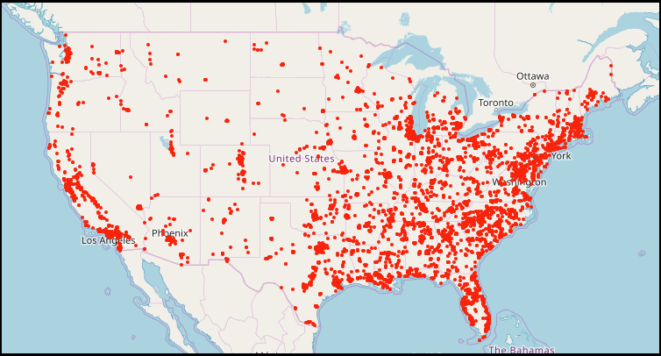
INCIDENTS IN 2019
Notes:
https://everytownresearch.org/gun-violence-america/

Slide 6
INDEPENDENT VARIABLES
NUMBER OF GUNS STOLEN (H)
NUMBER OF GUNS NOT STOLEN (I)
NUMBER OF ADULTS (J)
NUMBER OF TEENS (K)
NUMBER OF CHILDREN (L)
Number of injuries (m)
INCIDENT ID (A)
DATE OF INCIDENT (B)
REGION OF OCCURANCE (C)
NUMBER OF MALES (D)
NUMBER OF FEMALES (E)
TOTAL NUMBER OF GUNS (F)
NUMBER OF GUNS UNKNOWN (G)
DEPENDENT VARIABLES
NUMBER OF PEOPLE KILLED (Z)
Notes:
https://everytownresearch.org/gun-violence-america/

Slide 7
BINNING THE DATA
REGION OF OCCURANCE
STOLEN GUNS
NORTHEAST
MIDWEST & WEST
SOUTH
NO GUNS INVOLVED
MORE THAN 1 GUN INVOLVED
NUMBER OF MALES
NOT STOLEN GUNS
NO MALES INVOLVED
1 MALE INVOLVED
MORE THAN 1 MALE INVOLVED
NO GUNS INVOLVED
MORE THAN 1 GUN INVOLVED
NUMBER OF ADULTS
NUMBER OF FEMALES
NO ADULTS
1 ADULT INVOLVED
2 ADULTS INVOLVED
MORE THAN 2 ADULTS INVOLVED
NO FEMALES INVOLVED
MORE THAN 1 FEMALE INVOLVED
TOTAL NUMBER OF GUNS
NUMBER OF TEENS
NO GUNS INVOLVED
MORE THAN 1 GUN INVOLVED
NO TEENS INVOLVED
MORE THAN 1 TEEN INVOLVED
UNKNOWN GUNS
NUMBER OF CHILDREN
NO GUNS INVOLVED
MORE THAN 1 GUN INVOLVED
NO CHILDREN INVOLVED
MORE THAN 1 CHILD INVOLVED
NUMBER OF PEOPLE KILLED
NOBODY KILLED
MORE THAN 1 PERSON KILLED
Notes:
https://everytownresearch.org/gun-violence-america/

Slide 8
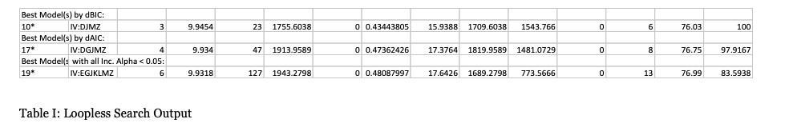
LOOPLESS SEARCH RESULTS

Slide 9
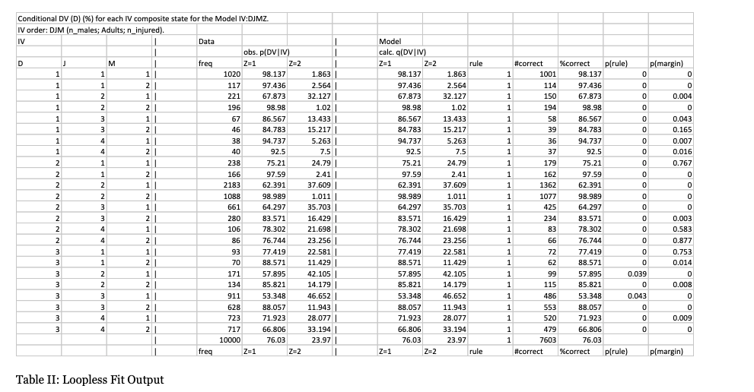
FITting the LOOPLESS SEARCH model

Slide 10

Interpretation
*
=
ADULTS
46.7% CHANCE SOMEONE GETS KILLED
Notes:
Z = 2 (46.652%) we have a corresponding minimum percentage of Z = 1 (53.348%). The dependent variable D is in state 3, J is in state 3 and M is in state 1 which means that there is a 46.652% chance of more than 1 person being killed if 2 adults, at least one of the 2 adults is a male, 2 adults and 0 people are injured during the incident.

Slide 11
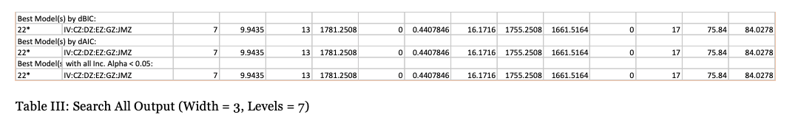
SEARCH all RESULTS

Slide 12
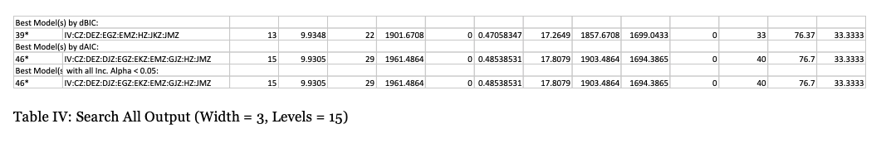
SEARCH all RESULTS

Slide 13
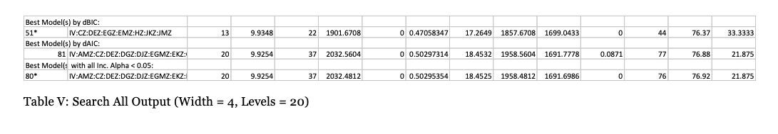
SEARCH all RESULTS

Slide 14
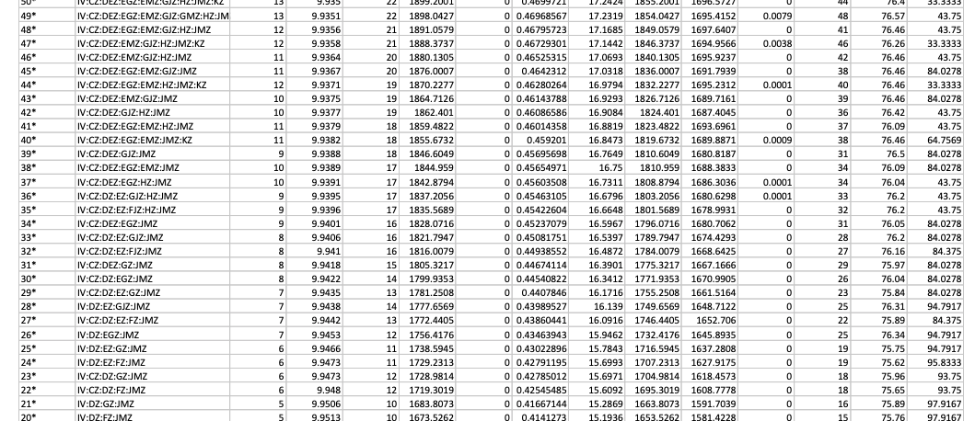
SEARCH all BEST MODEL

Slide 15
Fitting the SEARCH alL model
BEFORE WE FIT, WE HAVE TO OBTAIN THE COMPOSITE STATES OF EACH OF THE VARIABLES IN ORDER TO GAIN BETTER UNDERSTANDING OF WHAT THEY MEAN
MODEL = IV:CZ:DEZ:GJZ:JMZ

Slide 16
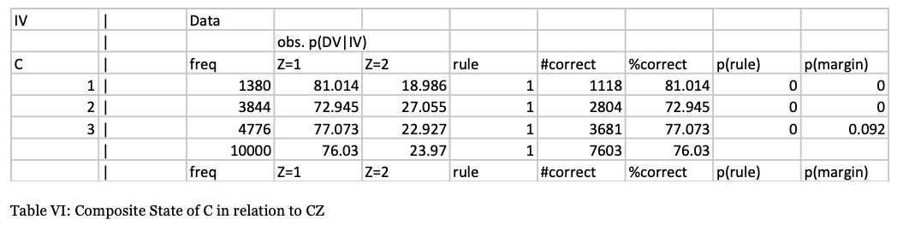
COMPOSITE STATE OF CZ
27% CHANCE SOMEONE GETS KILLED IF THEY LIVE IN WEST / MIDWEST

Slide 17
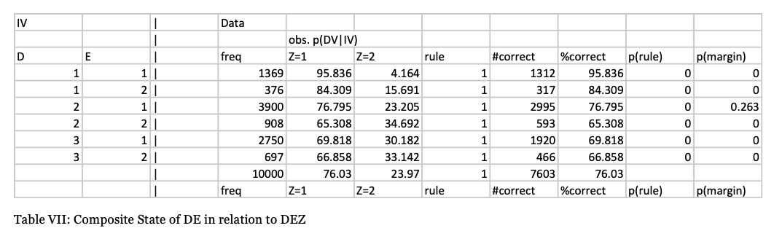
COMPOSITE STATE OF DEZ
35% CHANCE SOMEONE GETS KILLED IF 1 MALE, < 1 FEMALE INVOLVED

Slide 18
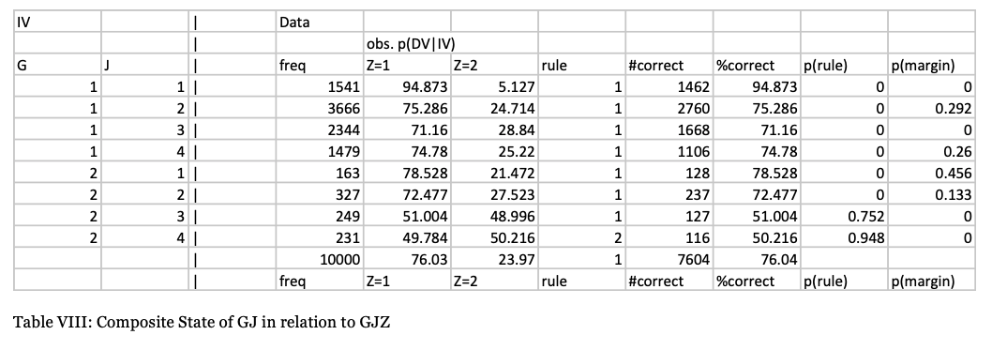
COMPOSITE STATE OF gjZ
50% CHANCE SOMEONE GETS KILLED IF <1 UNKNOWN GUNS, <3 ADULTS INVOLVED

Slide 19
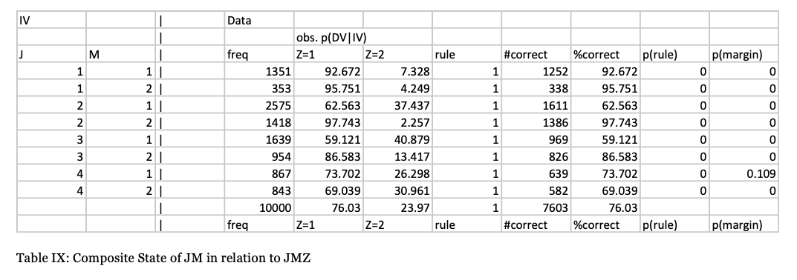
COMPOSITE STATE OF JMZ
41% CHANCE SOMEONE GETS KILLED IF 2 ADULTS INVOLVED & NO INJURIES

Slide 20
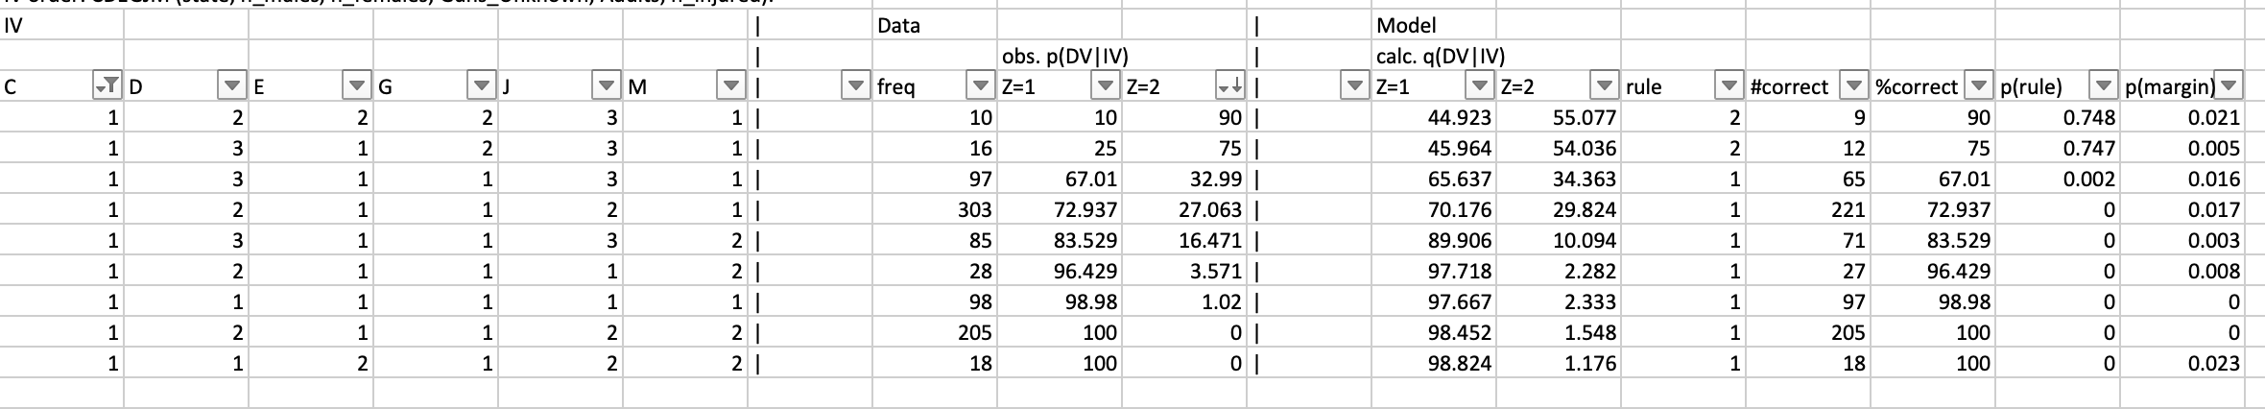
Fitting the SEARCH alL model
C = 1

Slide 21
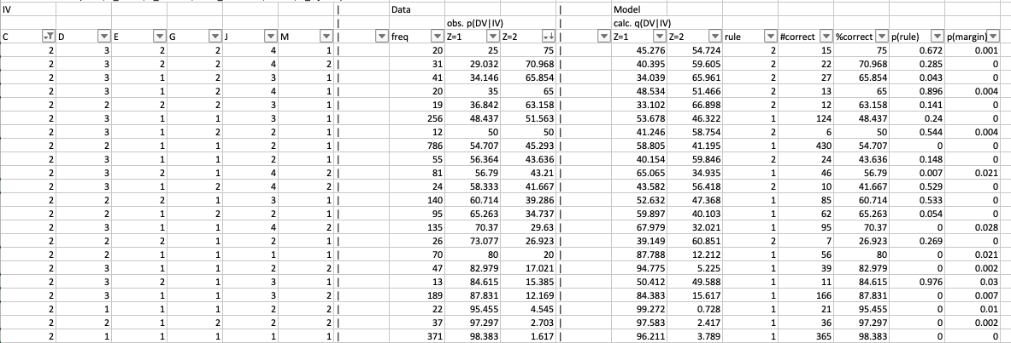
Fitting the SEARCH alL model
C = 2

Slide 22
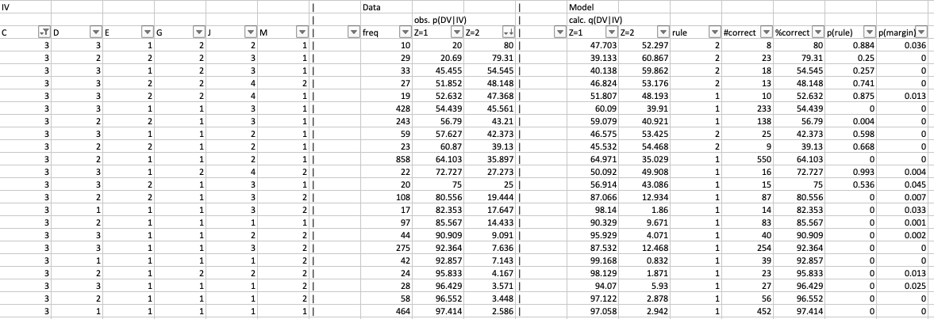
Fitting the SEARCH alL model
C = 3

Slide 23
PUTTING IT ALL TOGETHER

Slide 24


Interpretation of NORTHEAST REGION
*
*
+
+
ADULT <3
90% CHANCE SOMEONE GETS KILLED

Slide 25
Interpretation of WEST/MIDWEST REGION
*
*
+
+
ADULT x2
75% CHANCE SOMEONE GETS KILLED

Slide 26
Interpretation of south REGION
*
+
ADULT x1
80% CHANCE SOMEONE GETS KILLED

Slide 27
CONCLUSION
CAN STILL EXPLORE OTHER METHODS LIKE STATE BASED SEARCH TO CROSS REFERENCE
LOOK MORE INTO CERTAIN IV TO GET MORE GRANULAR RESULTS

Slide 28
Thank you

